Slide 1
Final Project Results
Diego Ferrer | Owen Farthing

Slide 2
Overview
Recap
Finding correlations between Robinhood user data and stock prices
Using correlated stocks to model and make predictions
Analyzing results to determine the usefulness of Robinhood data
Changes
Added K-Nearest Neighbor for modeling and prediction

Slide 3
Data Pipeline
Preprocessing
Loaded files into memory
Concatenated and formatted them
Calculated averages and correlation
Applied correlation threshold to filter stocks
Analysis
Trained and tested various models on combined data
Chose features useful for specific models
Plotted results against baselines

Slide 4
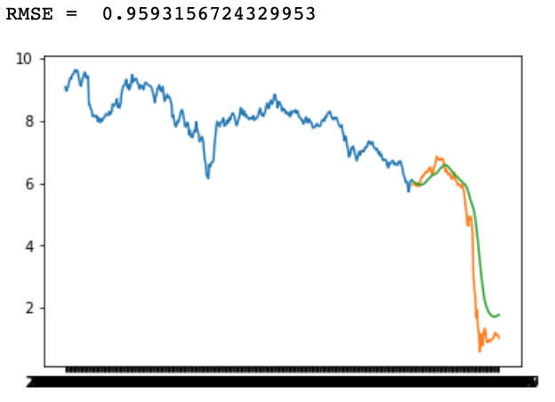
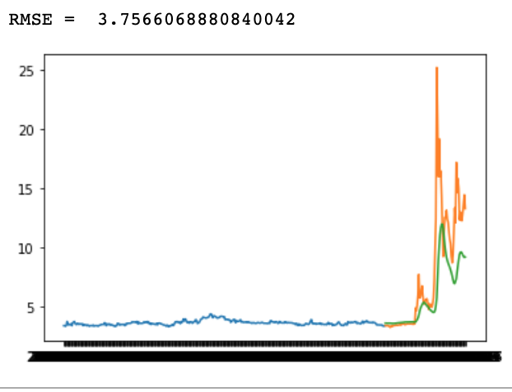
Univariate Long Short-Term Memory

Slide 5
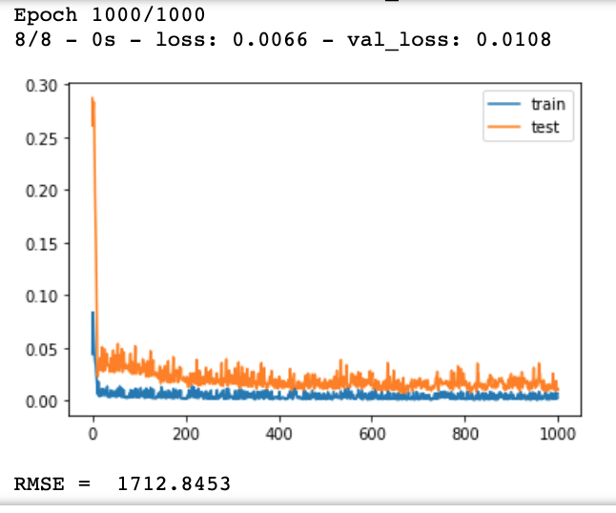
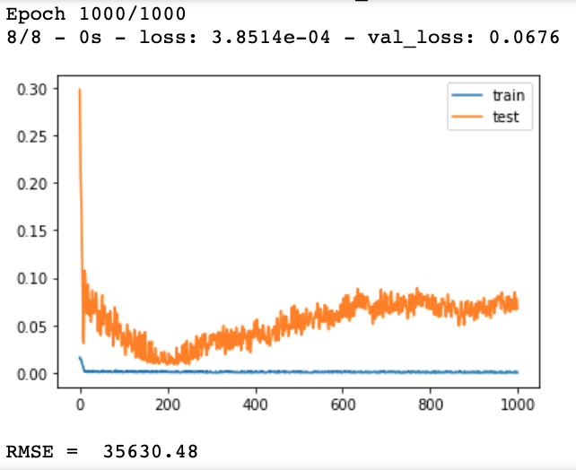
Multivariate Long Short-Term Memory

Slide 6
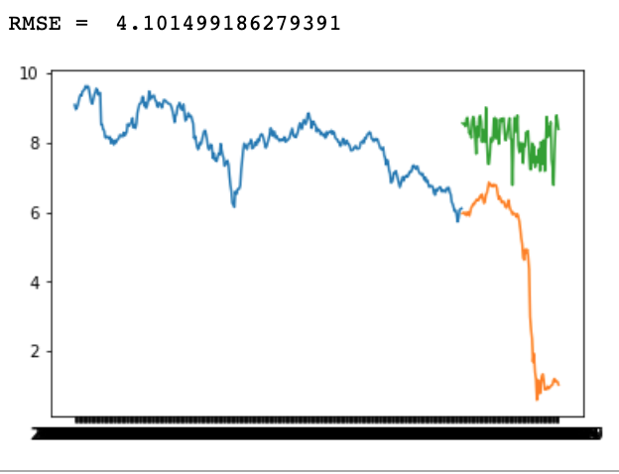
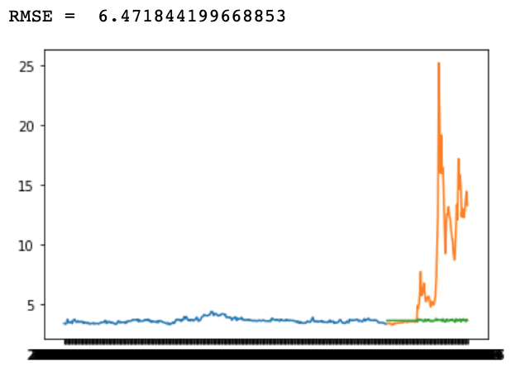
K-Nearest Neighbor Using Price

Slide 7
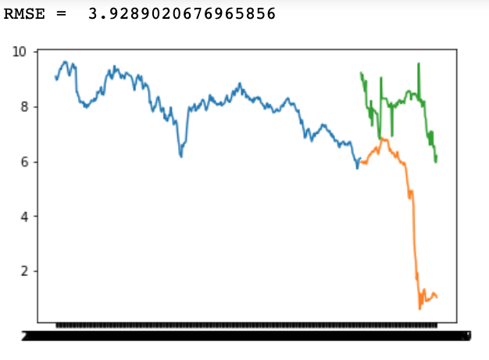
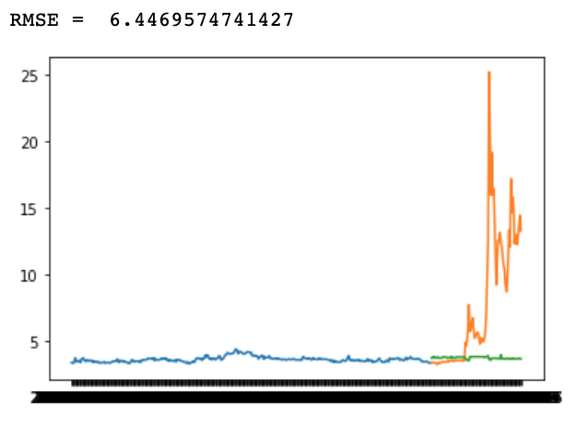
K-Nearest Neighbor Using Robinhood Data

Slide 8
Conclusion
Tools
SageMaker Jupyter Notebook
EMR
Pandas
Sklearn
Matplotlib
Impact
Discovered that Robinhood user popularity was not a good predictor of future price for stocks with high historical correlation with Robinhood popularity

